Slide 1
LENDING CLUB CASE STUDY
- Jimmy Ha
- Mrunmai Khedekar

Slide 2
Business Objective
The company wants to understand the driving factors (or driver variables) behind loan default
The company can utilise this knowledge for its portfolio and risk assessment.
The company wants to understand the strong indicators of default

Slide 3
Data Cleaning
The original data has 39717 rows and 111 columns
54 Empty Columns
9 columns with only 1 unique value across rows
14 unnecessary fields
4 fields with value 0 in most rows and some outliers
2 fields with more than 90% null values
Dropped all the above columns
After cleaning up, the df_loan has 25 columns left.

Slide 4
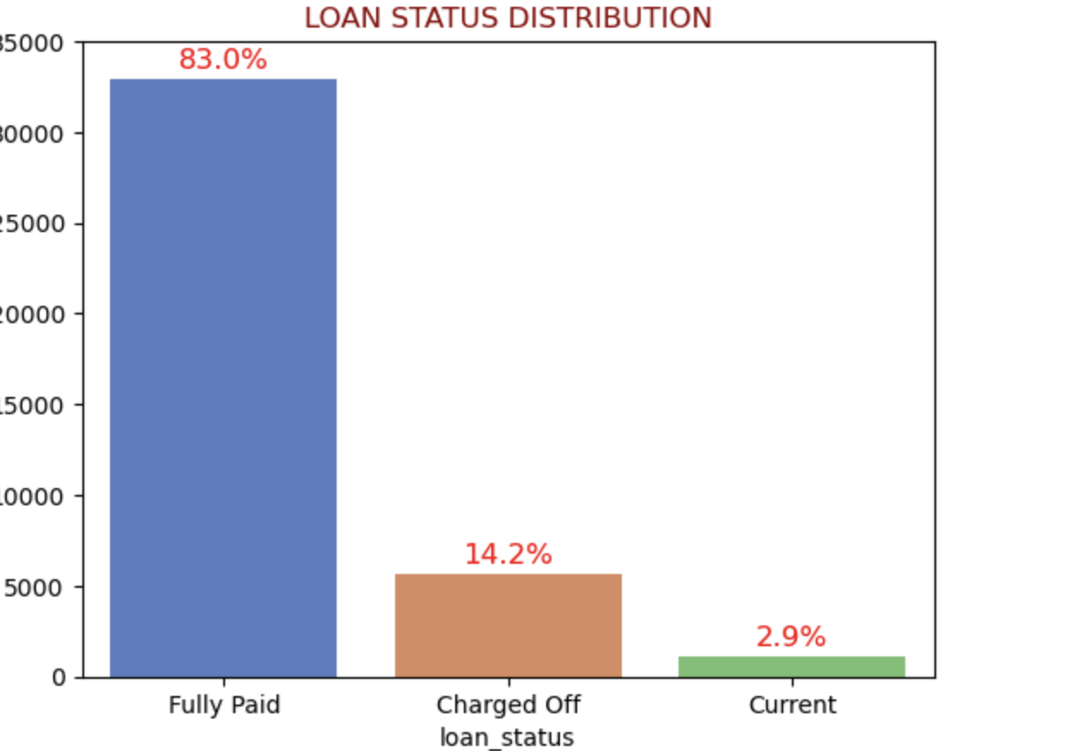
Loan Status
14.2 % of loans are defaulted
Loan Status

Slide 5
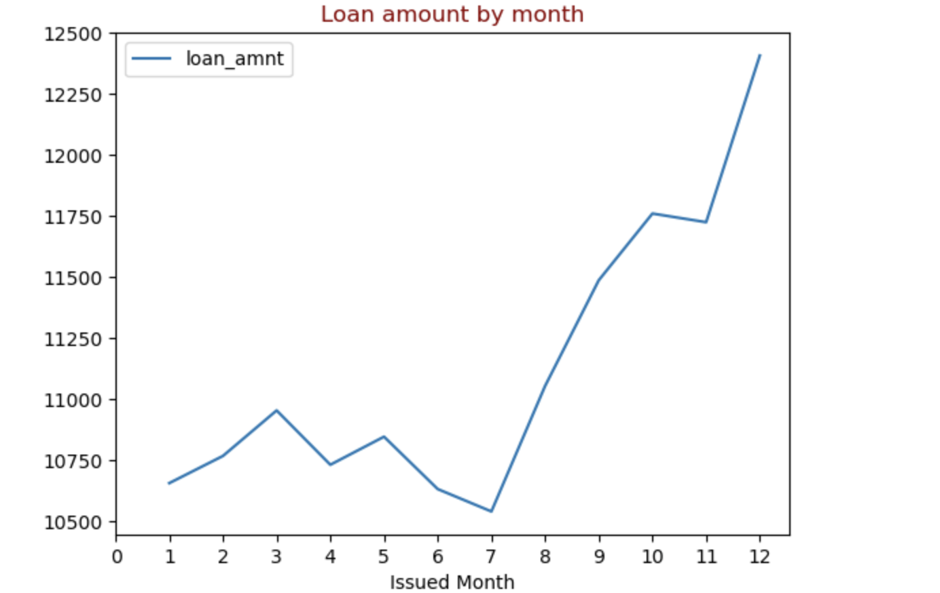
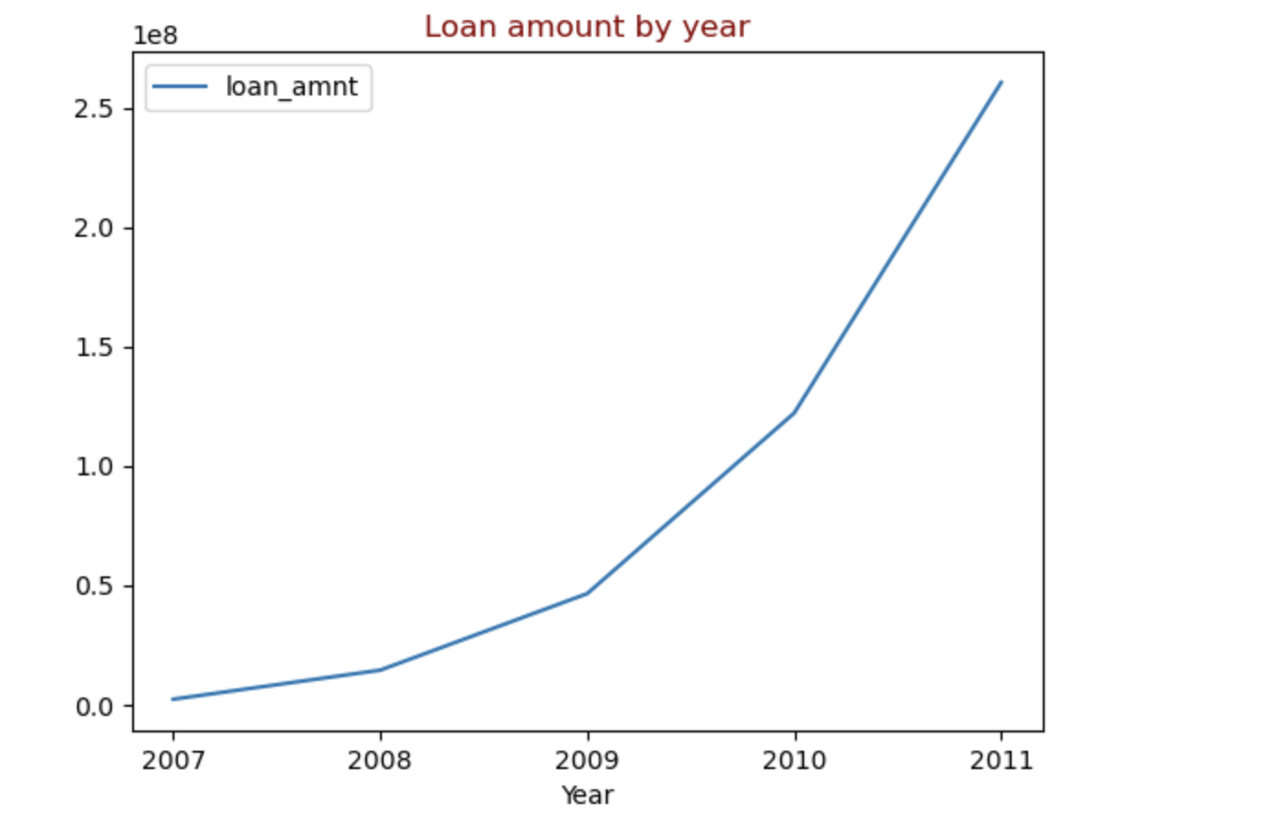
Loan vs Time by Year
Number of loan applications are increasing over time
The number of applications seem to increase after 7th month

Slide 6
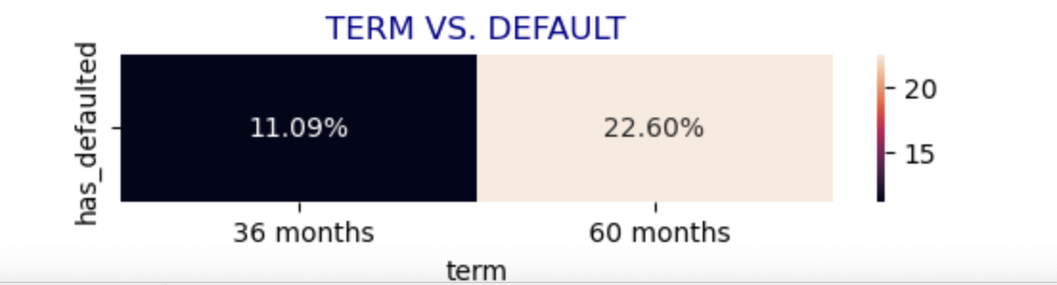
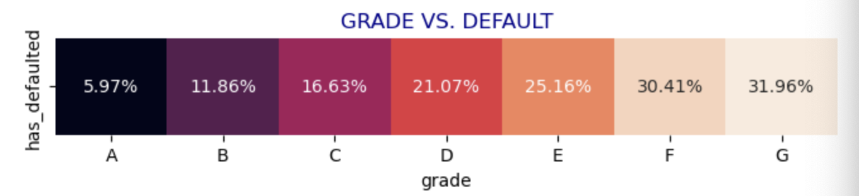
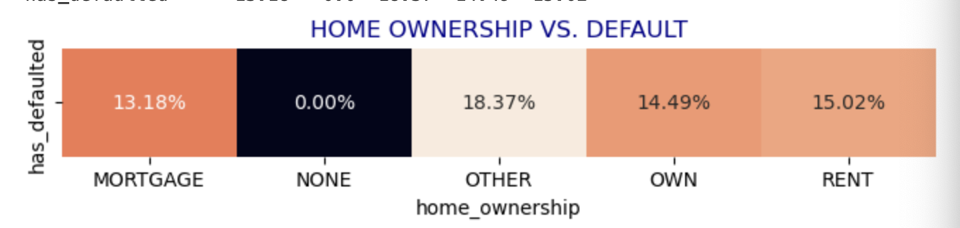
Term Distribution, Grade, Home Ownership
For Default loans
The loan borrowers with 60 months( 22.60 %) term have comparatively defaulted the loan then 36 months (11.09 %)
The loan borrowers in Grade G(31.96 %), F (30.41 %), E(25.61%) have defaulted comparatively to other grades
The other(18.37%) home ownership defaulter is greater than rental (15.02%) and mortgage(13.18%)

Slide 7
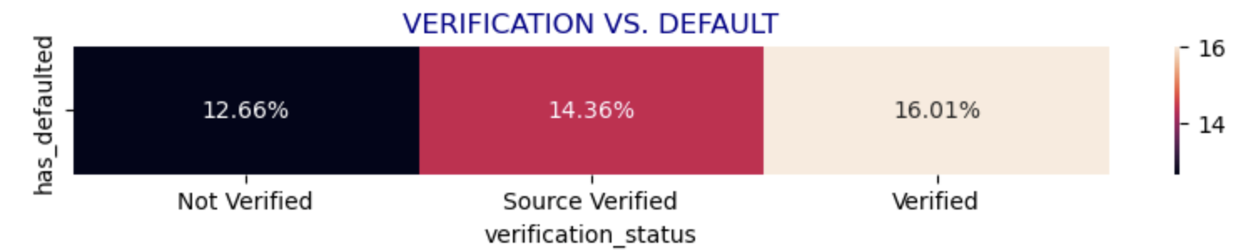
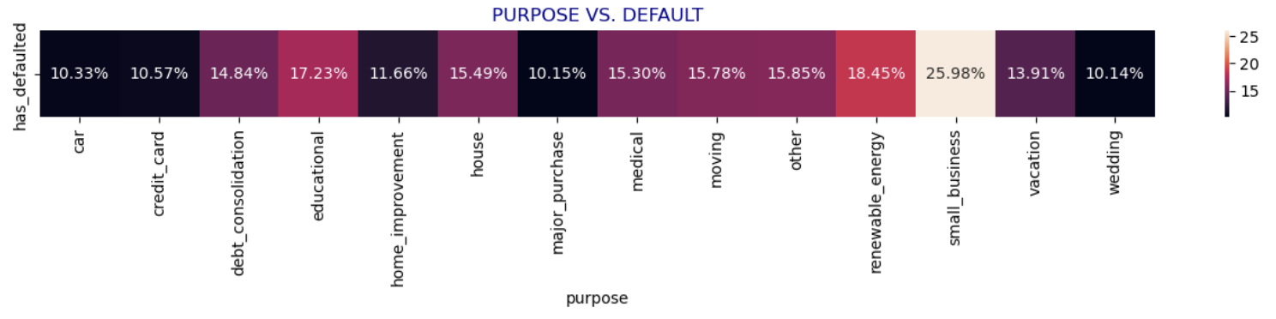
Loan Verification, Purpose for Default loans
Loan defaulters is greater in verified(16.01%) source than not verified (12.66%)
The loan borrower defaulted had loan purpose as small business (25.98%)

Slide 8
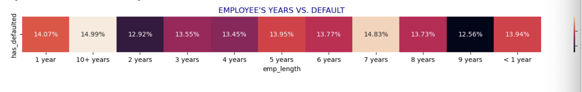
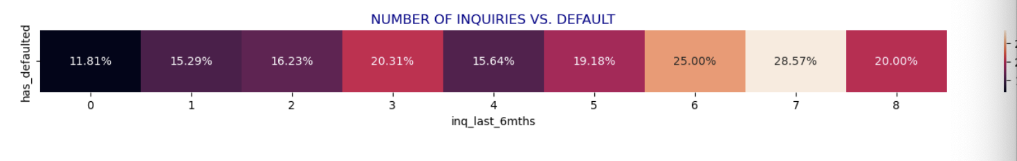
Employee length and number of enquires
The loan defaulting is greater in employee length 10+ years (14.99%)
The number of inquires 3 in last 6 months is greater 20.31%

Slide 9
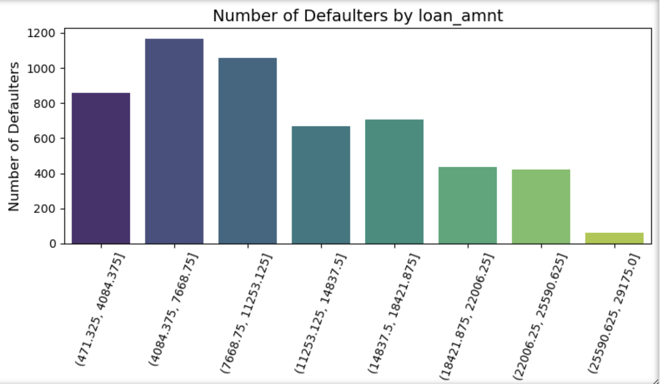
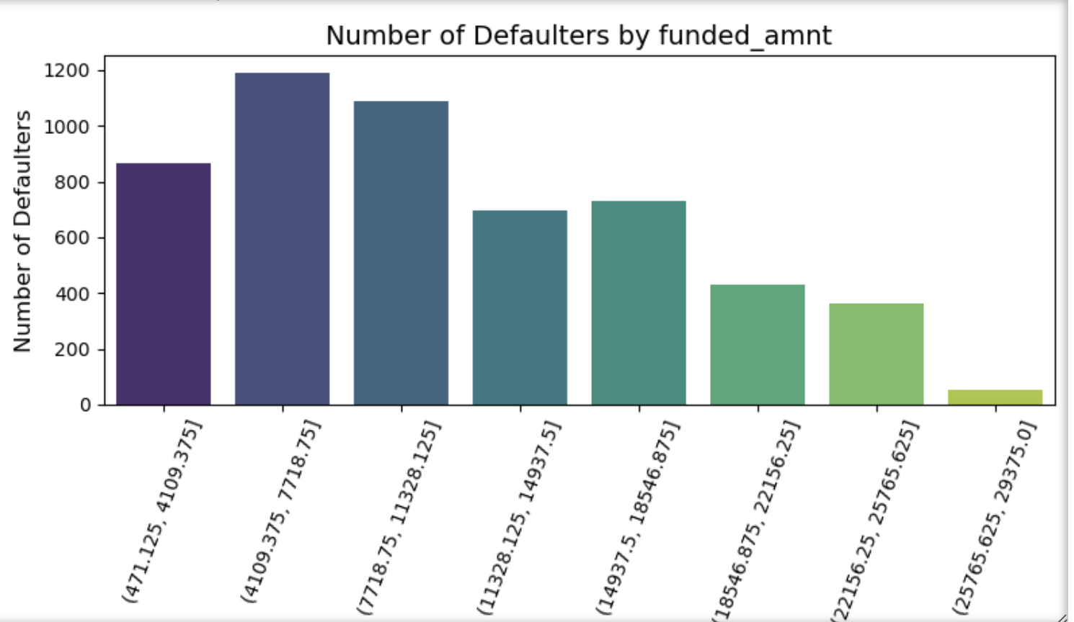
Loan Amount, Funded Amount for default loan
The number of defaulters is comparatively high in loan amount range 4084.375 to 7668.75
The number of defaulters is comparatively high in funded amount range 4109.375 to 7118

Slide 10
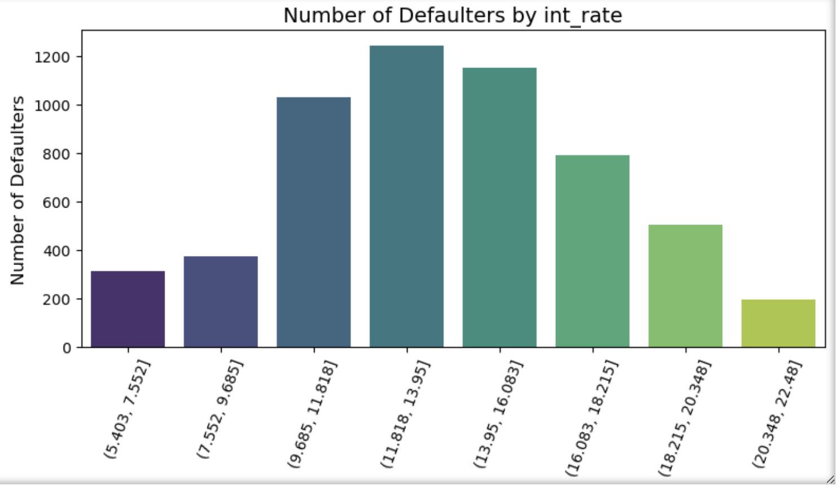
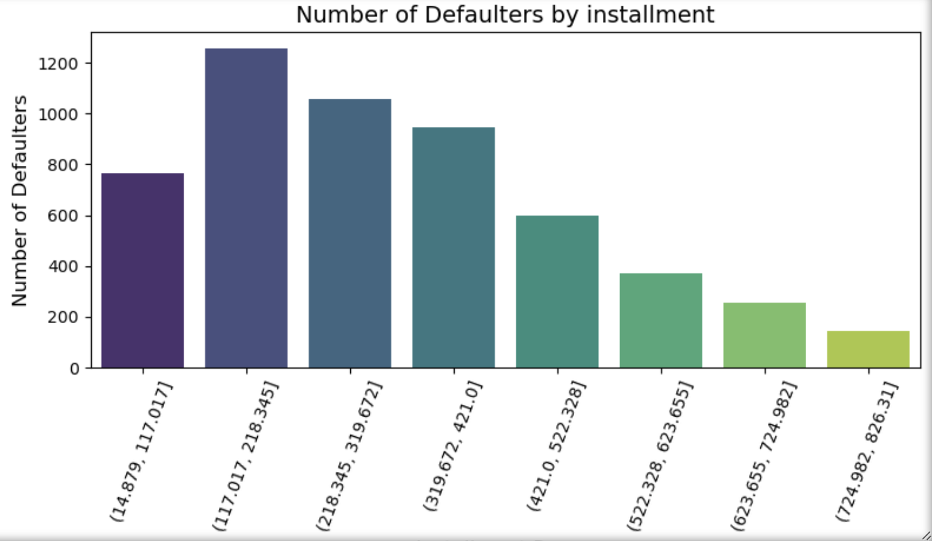
Interest rate, Installment for default loan
Interest rate in range 11.8 to 13.95 has comparatively high defaulters
For installment range 117.017 to 218.354 has high defaulters

Slide 11
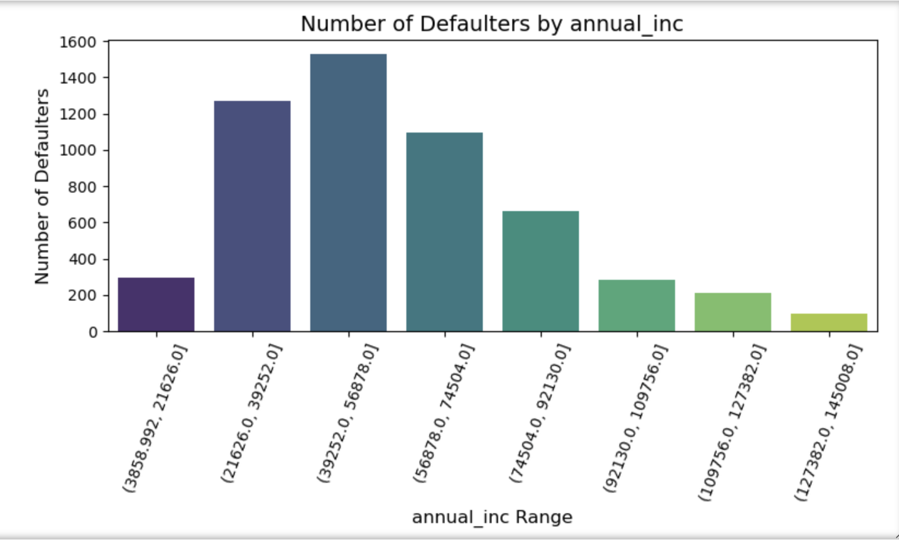
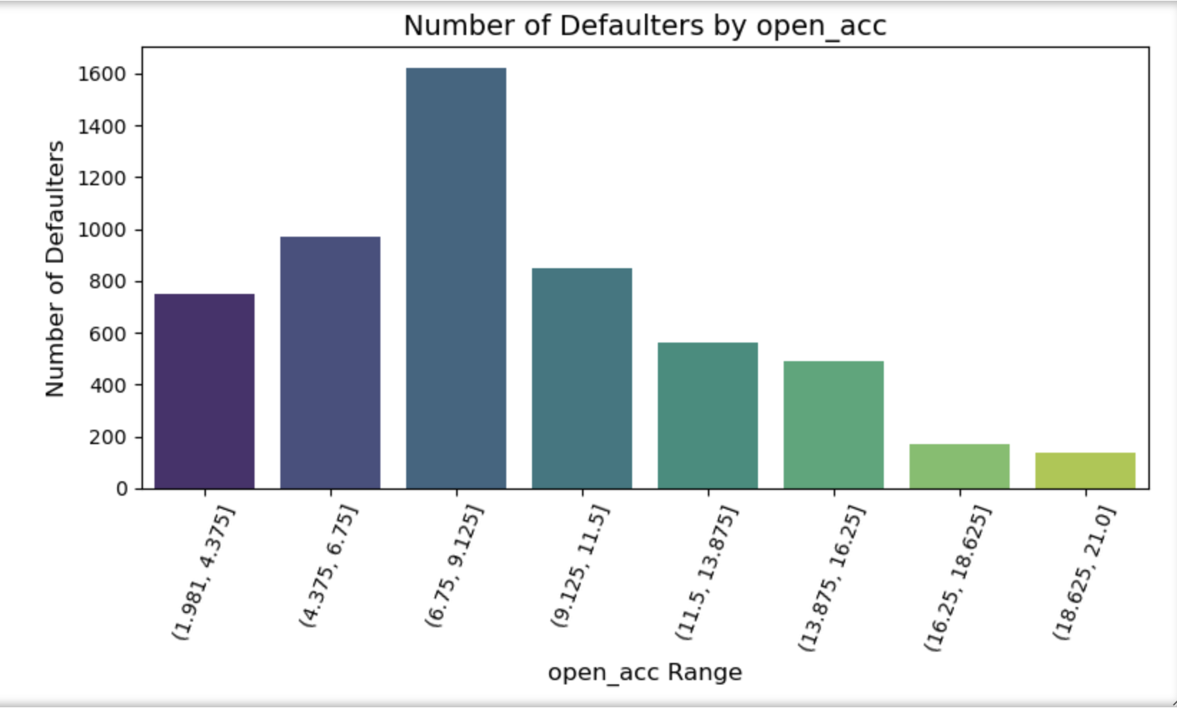
Annual Income, Open Accounts for loan defaulter
The loan borrowers having annual income in range 39252.0 - 566878.0 have comparatively higher defaulters
The loan borrowers having open account in range 6 to 9 have comparatively higher defaulters

Slide 12
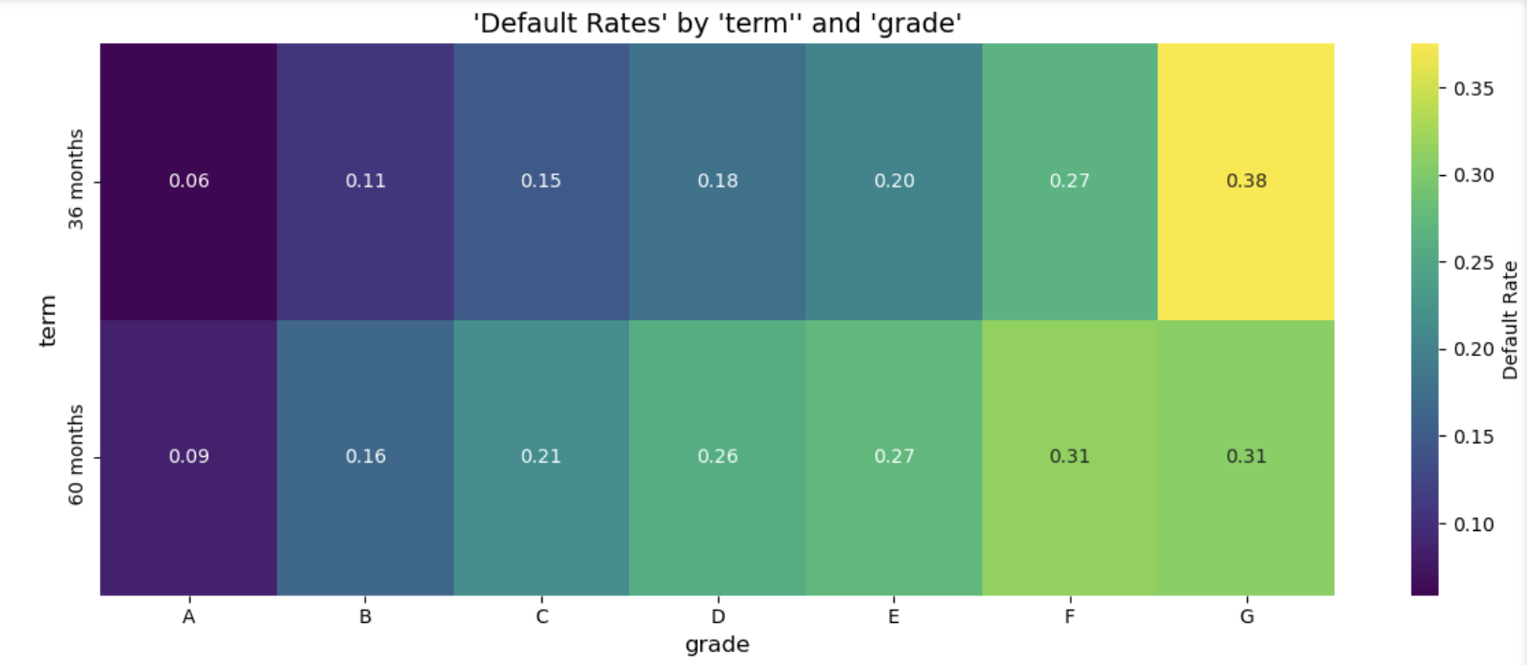
Default rate by term and grade
For the term 36 months and grade G shows higher default rate -0.38
For term 60 months and grade G shows higher default rate - 0.31

Slide 13
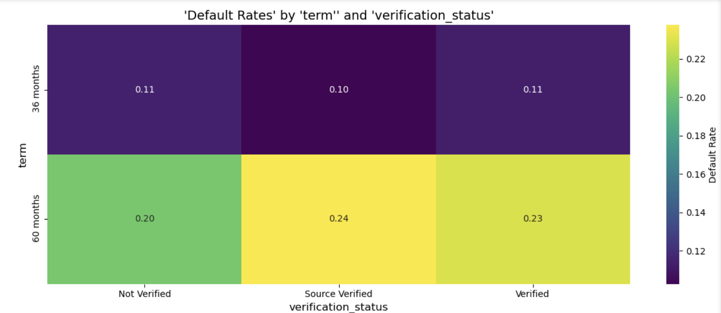
Default rate by term and verification status
For term 60 months and source verified the default rate is higher 0.24 followed by verification source as verified which 0.23

Slide 14
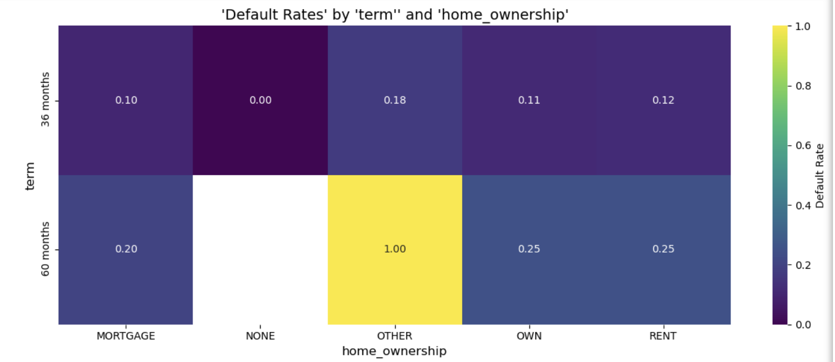
Default rate by term and home ownership
The default rate for term and home ownership is comparatively higher for home ownership as other 1.00

Slide 15
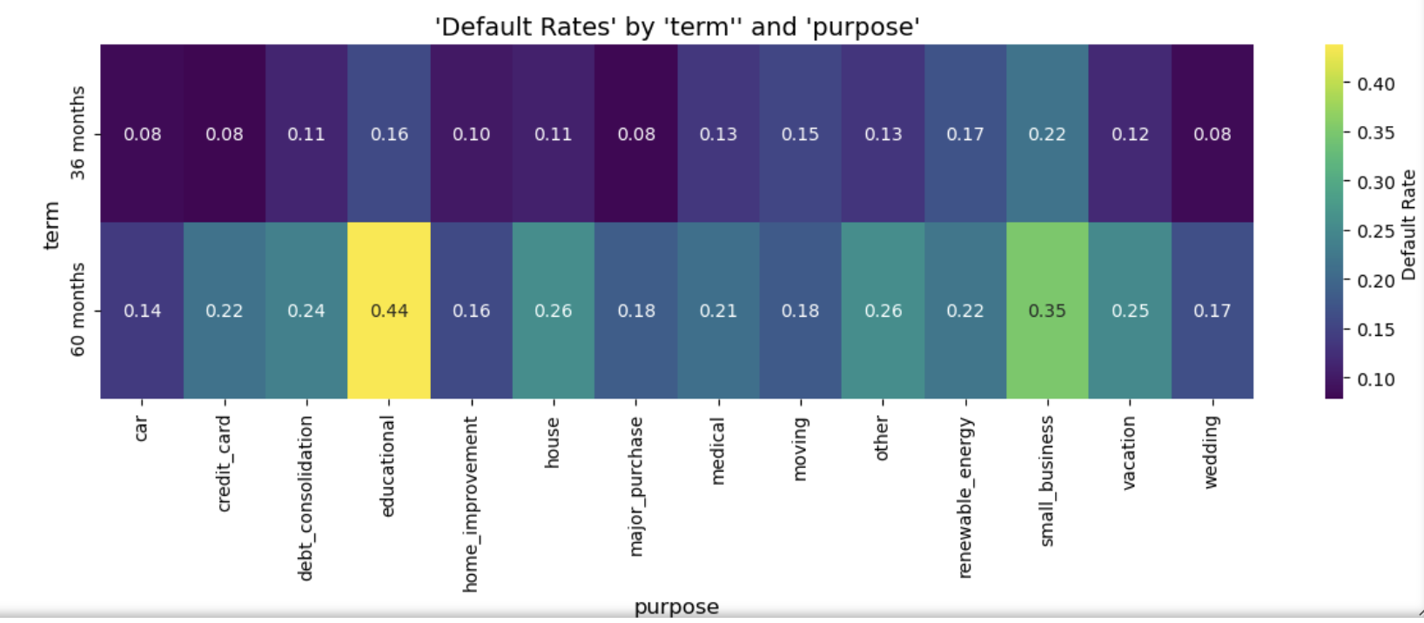
Default rate by term and purpose
Defaulter rate is significantly higher for purpose ‘educational’ for term 60 months

Slide 16
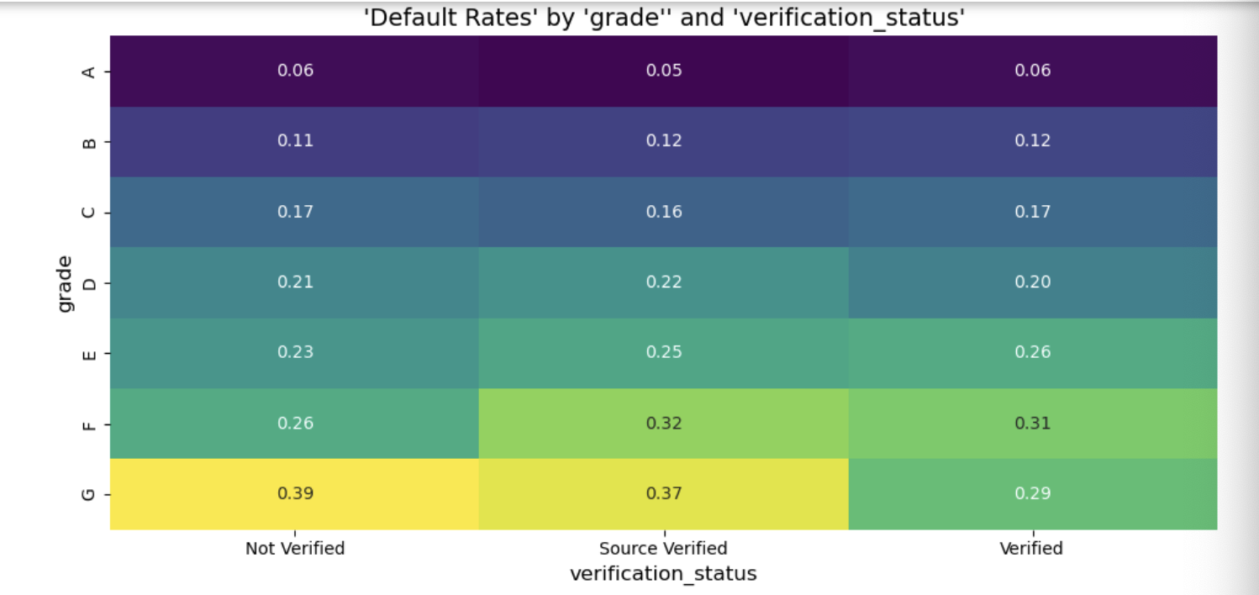
Default rate by grade and verification status
Default rate is high for Grade G for not verified status, followed by source verified and verified

Slide 17
Key Insights
The loan borrowers from Grade G, F and E have comparatively defaulted the loan
Interest rate with range form 11-19 % showed more defaulters
The default rate is high for grade G for 60 months term
The default rate is high for home ownership ‘other’ for 60 months term

